Slide 1

MANAGING DATA AS AN ASSET
Thomas MacPherson, Manager of Transportation AM, York Region
Aman Singh, Senior Partner, SLBC
Elaine Chang, Partner, SLBC
Notes:
In the field of Asset Management data is typically considered an enabler of AM activities
Delivery of transportation services relies on accurate and timely data to support infrastructure operations, maintenance, planning and capital delivery
The Transportation Data AM Plan conforms with the Region's Information Management Policy that recognizes data as an asset to be managed like any other asset essential to delivery of transportation services

Slide 2

AGENDA
Context:
Asset Management at York Region
Transportation Data Asset Management Plan
  State of Asset Data
  Levels of Service
  Future Demand
  Risk Management
  Lifecycle Strategy
  Financial Strategy
  Improvement Plan
Notes:
For our agenda today, we’ll start off with an overview of the asset management context at York Region. Following this, we’ll present the development and outcomes of the transportation data AMP, including the development of:
The state of asset data
Levels of service
Future demand
Risk
Lifecycle management
Financial strategy
And improvement plan.
And we’ll close with any questions from the audience.

Slide 3
ASSET MANAGEMENT AT
YORK REGION

Slide 4

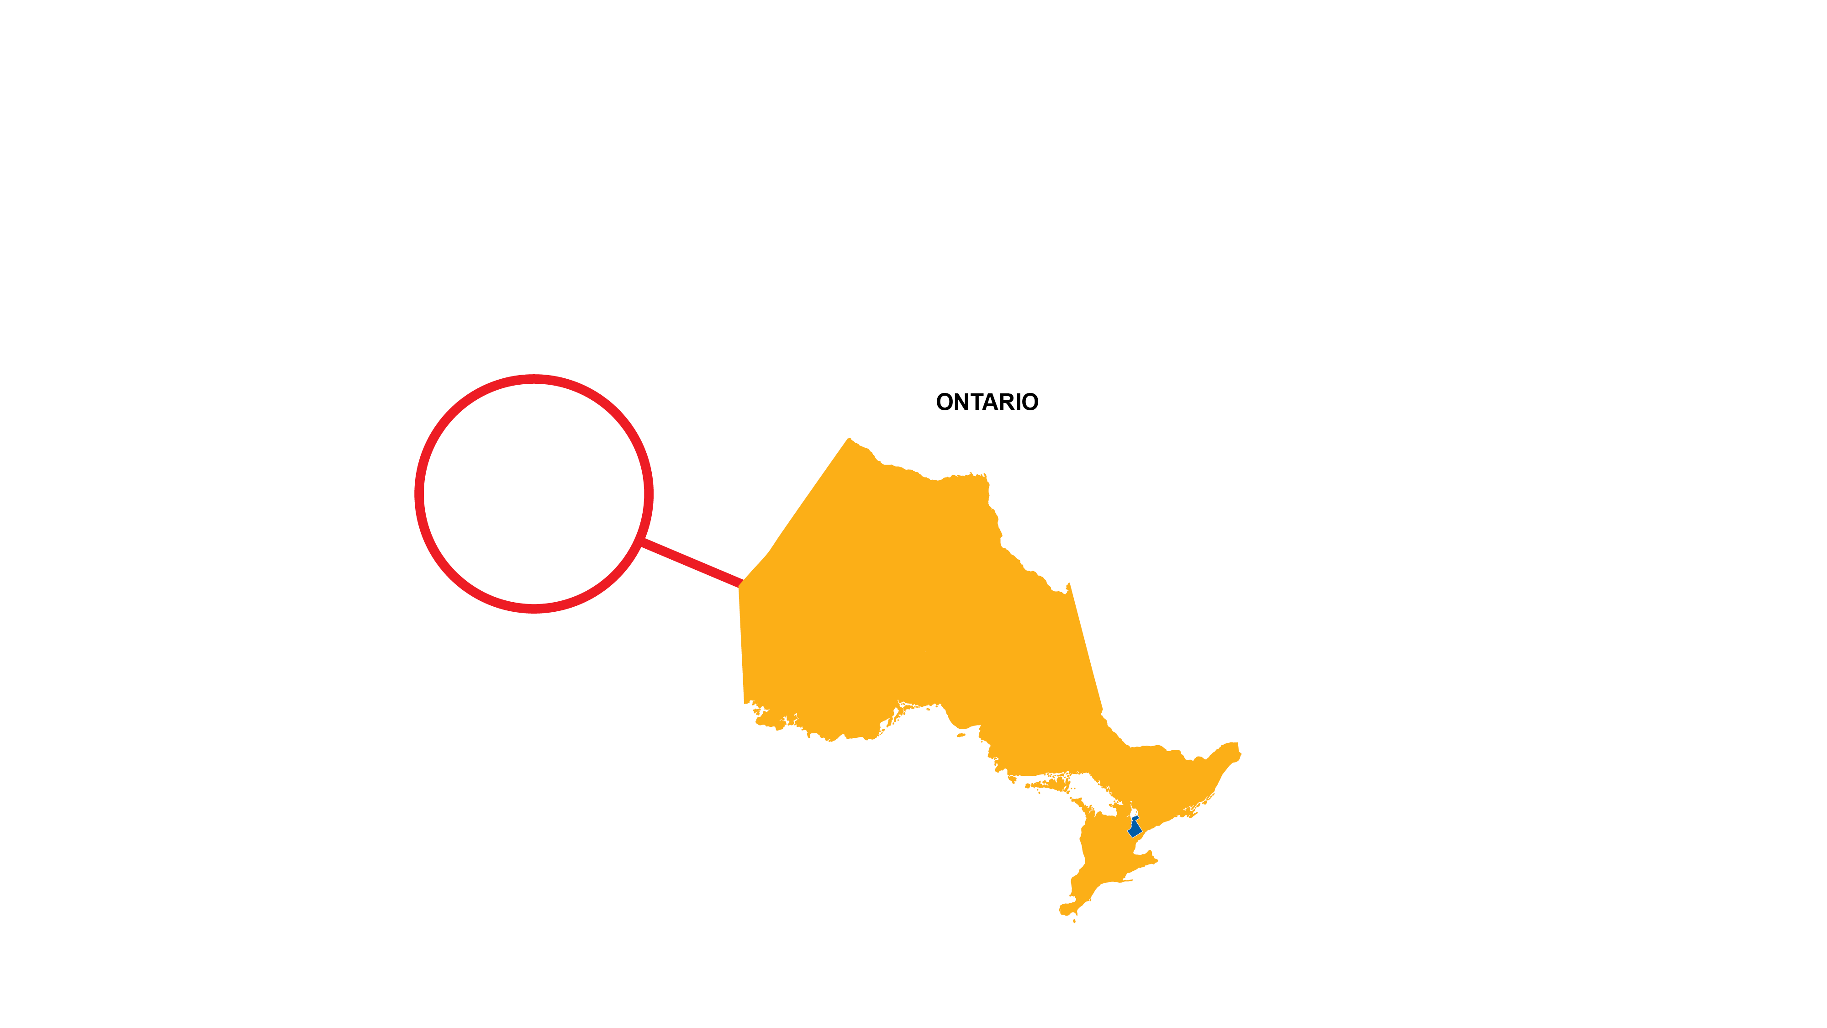

Where is York Region?
Located just north of Toronto, Ontario

Slide 5

COUNCIL LONG-TERM INVESTMENT
Notes:
One of the great decisions our Council made was creating an Asset Replacement Reserve in 2006
Council 2006 asset replacement reserve investment
Annual investment of 1% of tax levy
Using the funding in the reserve, Council approved
Dedicated staff
The Senior Management Team, through Council, made the decision to utilize the reserve to fund the shortfall in the pavement program
The number one priority of our asset management team is to ensure the investment our Council has made is supported, which is why we turned to our Project Management Office to utilize some of the

Slide 6
PERFORMANCE MANAGEMENT
“Performance Management is an umbrella term that describes
the methodologies, metrics, process and systems used
to monitor and manage the business performance of an organization.” (Gartner.com)
Notes:
The Project Management Office at York Region has created an integrated management system that is designed to bring together tools, processes and best practices that drive continuous improvement, innovation and business excellence in Transportation Services.
This management system include disciplines such as Process Management, Change Management, Portfolio Management, Project Management and Performance Management

Slide 7
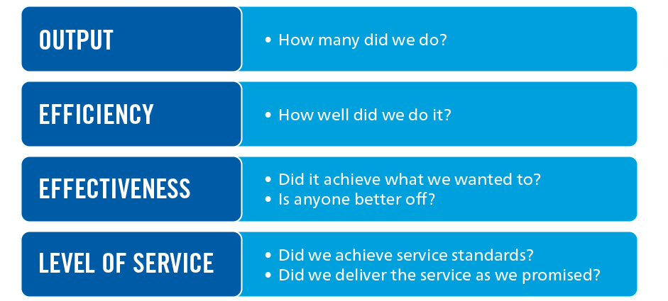
PERFORMANCE MEASUREMENT TYPES
Notes:
Our PMO team used industry best practices to layout different performance measurement types including:
Output
Efficiency
Effectiveness
Level of Service
We understood that to answer these questions, and answer them well, we need to make a data investment

Slide 8
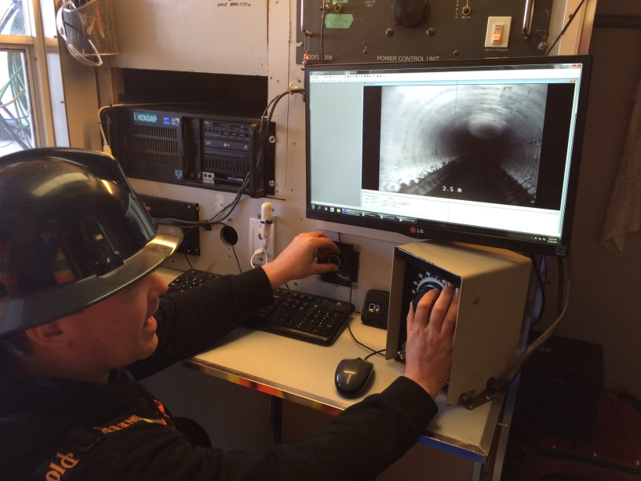
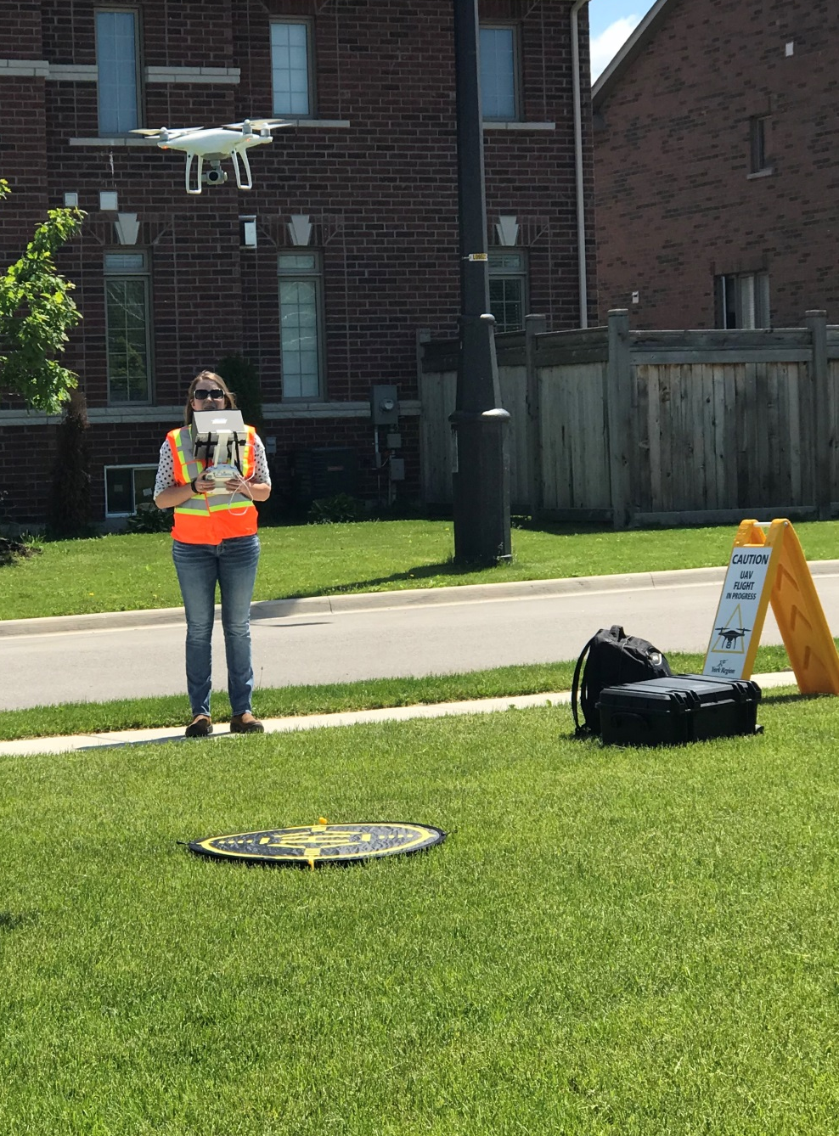
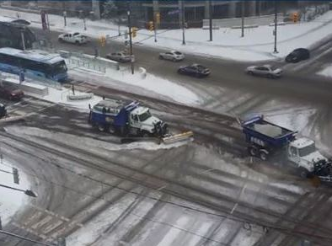
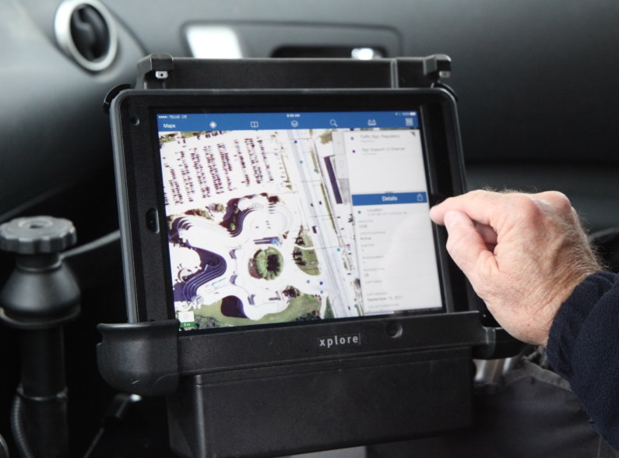
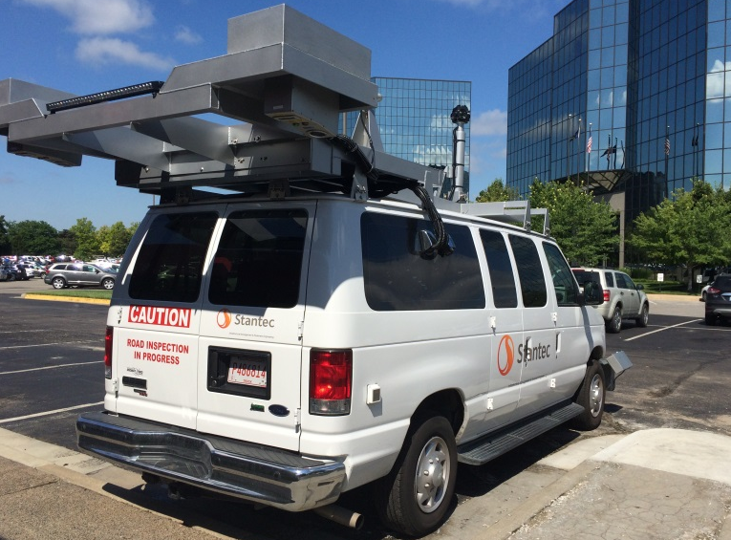
Data INVESTMENT
Notes:
Before we moved forward with the investment, we needed data, lots and lots of data that our team could analyze to ensure we made the best decisions possible

Slide 9
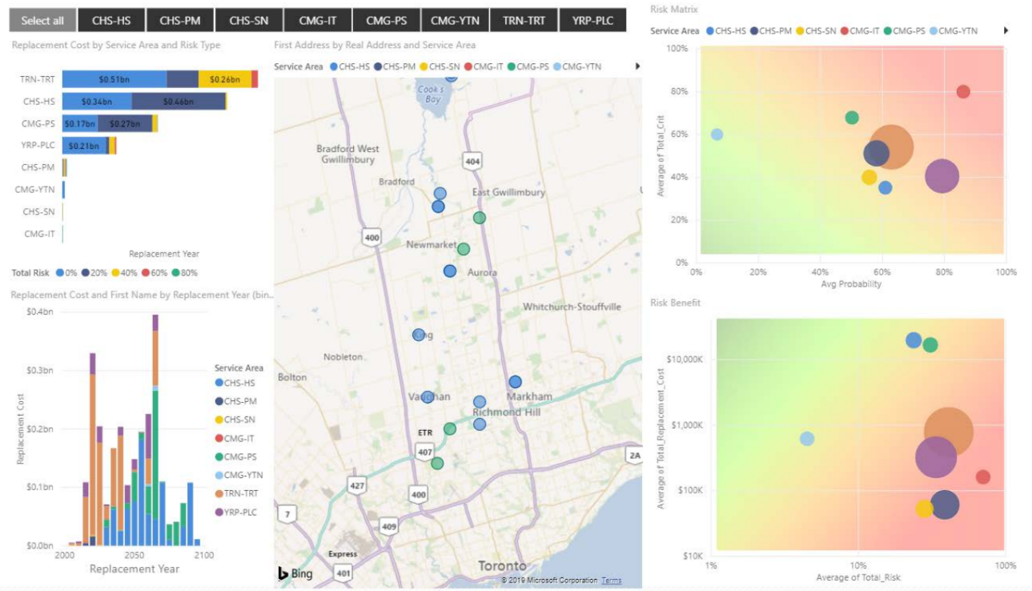
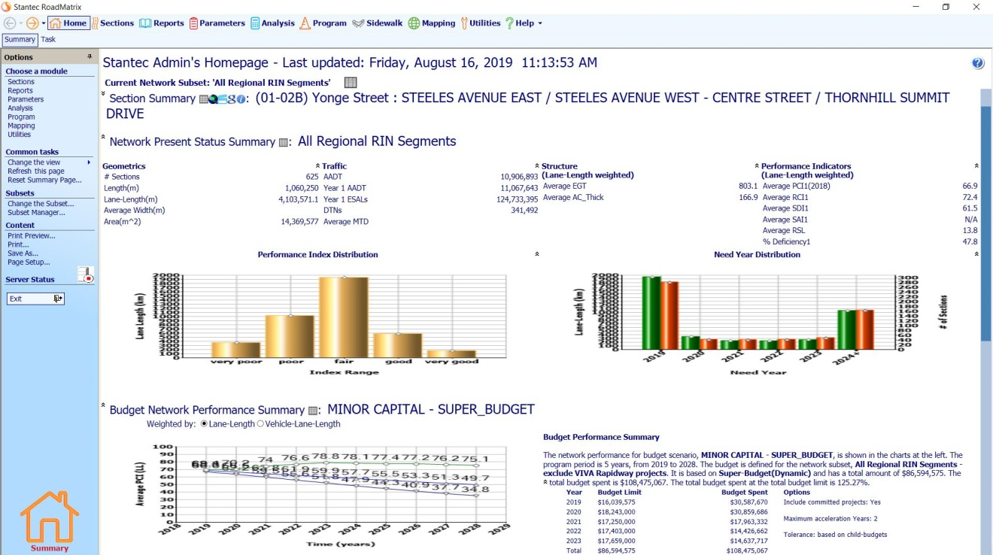
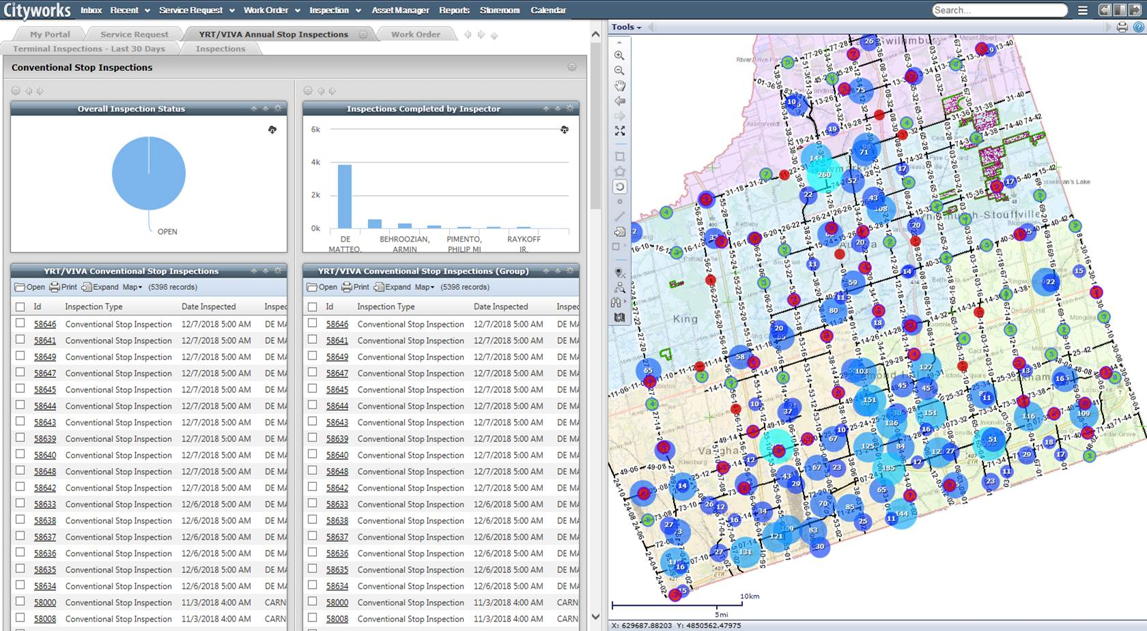
Data INVESTMENT

Slide 10
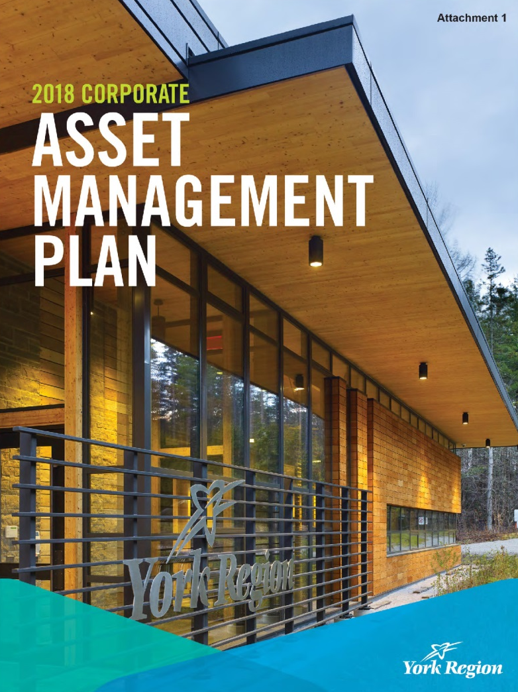
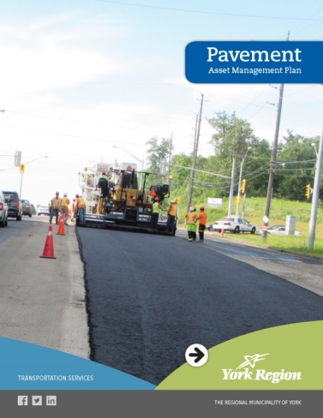
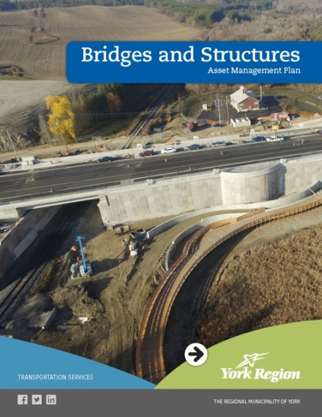
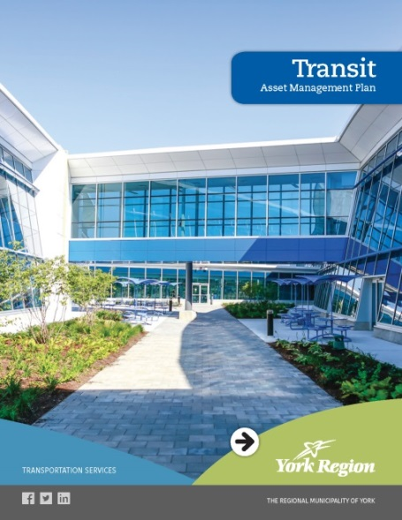
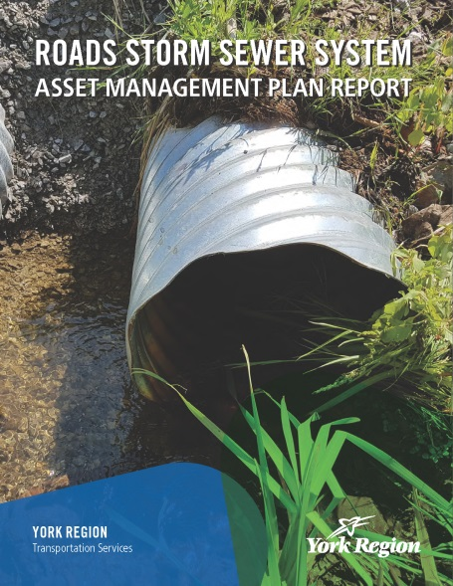
Asset management planning

Slide 11




PERFORMANCE-Based DECISIONS: SERVICE benefits
Increased Business Knowledge
Increased Decision Confidence
Increased Business Effectiveness
Consistent Delivery
Notes:
Doing data collection, analysis, asset management planning and renewal programming is great. They are the fundamentals for what needs to be done for any asset management program.
The question is, how do we know all this work, these investments, are working and benefitting our communities?
This is why we worked with our Project Management Office and Finance teams to ensure we could track the performance of our work.
Which leads us to the immeasurable benefits
In this short time, our asset management team has already found immeasurable benefits to our business performance:
Increased business knowledge
Increased business effectiveness
Increased decision confidence
Consistent delivery

Slide 12
Transportation Data
Asset Management Plan
Notes:
Turn it over to SLBC to discuss how they completed the data AMP.

Slide 13
State of Assets
Inventory
Valuation
Condition
Notes:
Good morning, the next part of the presentation will focus on how we developed key elements of the data AM Plan and show what some of the actual outcomes.
We’ll start with the State of Assets which includes the inventory, valuation and condition profile of the data assets.

Slide 14

What data assets are included in the Data AM Plan?
Asset Type
Road Pavement (4,140 lane-km)
Bridges and Structures (359 structures)
Road Structures
Sustainable Mobility
Traffic Management (784 intersections)
Stormwater Management (596 km of mains)
Road Operations Capital Assets
Fleet (~300 units)
Transportation Business Systems
Rapidways (27.3 centreline km)
Transit (577 buses, 4 garages, 7 terminals, 5000+ stops)
Notes:
The inventory for the data AM plan consists of the data assets that support the Region’s transportation services including roads and transit. The data we looked at also focused on asset management planning data.
The assets types included in the AM plan are listed here.
Future iterations of the plan will include data assets that support other activities such as demand and utilization planning, as well as work management

Slide 15
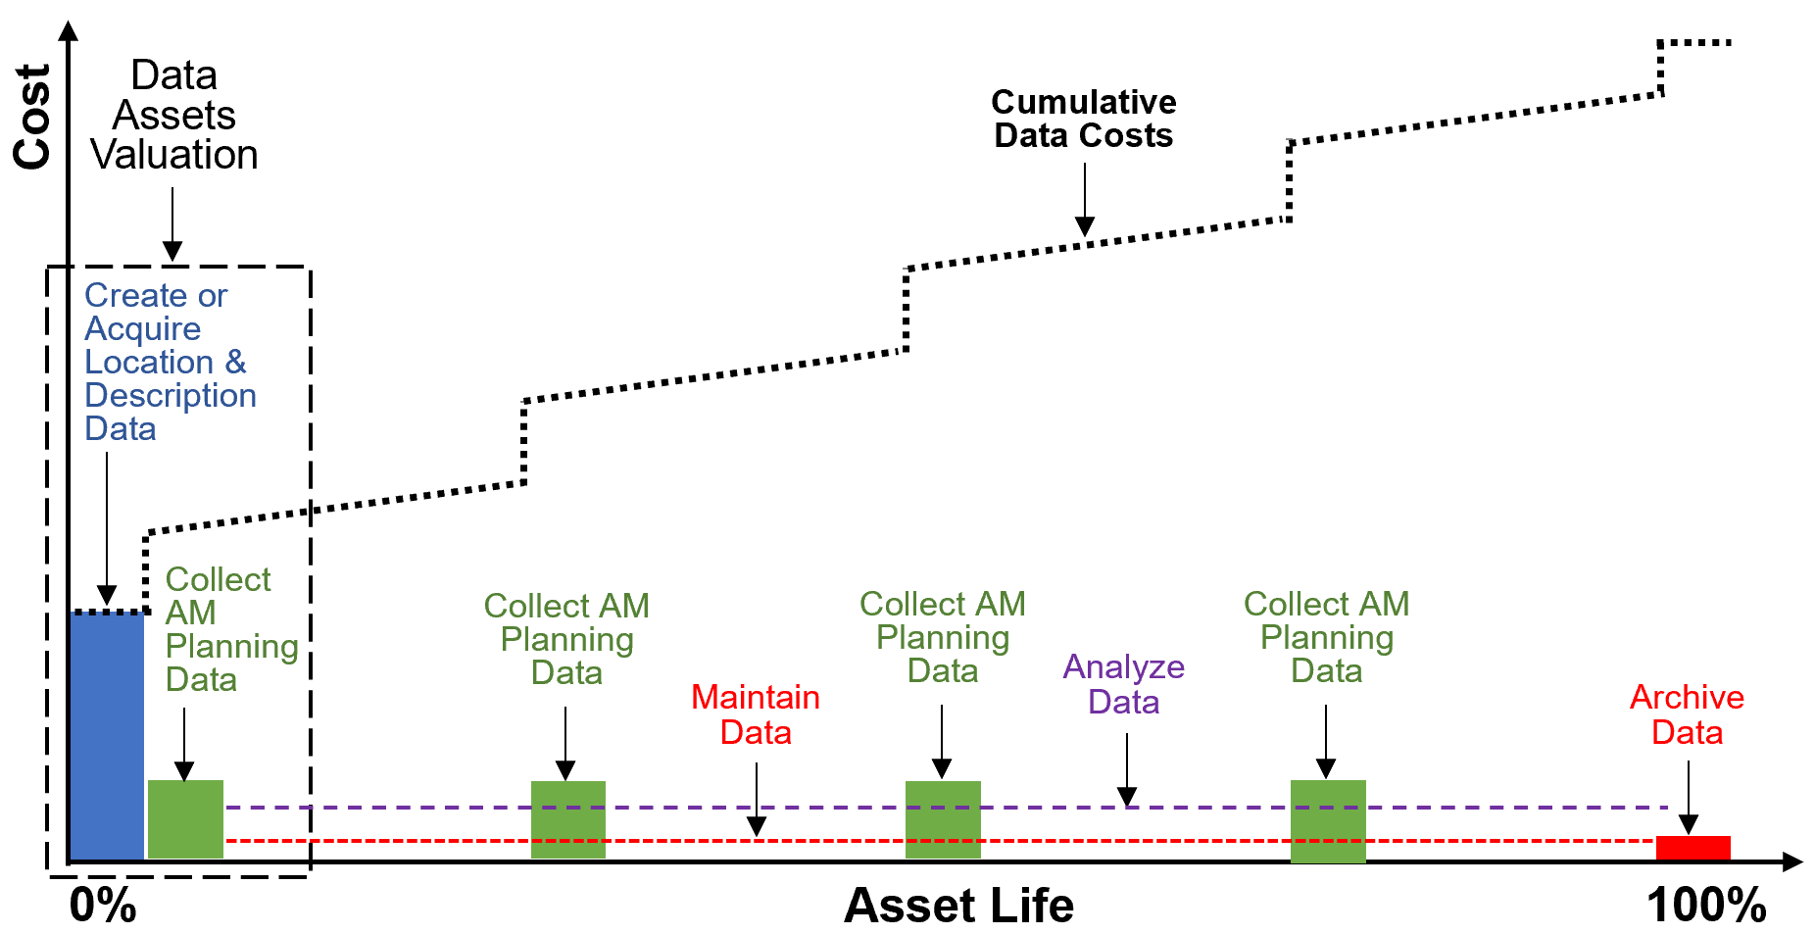
Data Valuation & Asset Data Lifecycle
Notes:
In general, the cost model shown here can be used to assess the value of data – based on the activity costs to create data, collect data, analyze data, maintain data and archive data.

Slide 16
Data Valuation & Asset Data Lifecycle
  Data creation costs: activities to provide location and description data
  Data collection costs: activities to provide AM planning data as well as the base data for analysis of asset condition, maintenance, utilization, operations and performance
  Data analysis costs: activities to examine raw data to make AM performance decisions
  Data maintenance costs: activities to make data available when needed , consistent between databases and to identify data that can be put into long term storage.
  Data archiving costs: activities to archive and store data
Notes:
Data creation costs: activities to provide location and description data
Data collection costs: activities to provide AM planning data and provides the base data for analysis of asset condition/maintenance, utilization/operations and performance
Data analysis costs: activities to examine raw data to make AM performance decisions.
Data maintenance costs: activities to make data available when needed, consistent between databases and to identify data that can be put into long term storage.
Data archiving costs: activities to archive and store data

Slide 17
State of Asset Data
Location + Description Data
Initial AM Planning Data
Cost to create data / AARR
Valuation Summary
Value of Created Data = cost to create data / Average Annual Renewal Rate
Total Valuation = Value of Created Data + cost to collect data (year 1)
Asset Type | Annual Cost to Create Data | Annual Cost to Collect Data | AARR | Value of Created Data | Total Valuation
Bridges and Structures | $0.051 | $0.352 | 1.25% | $4.10 | $4.45
Roadside Structures | $0.300 | $0.404 | 4.00% | $7.50 | $7.90
Road Pavement | $0.237 | $0.965 | 2.50% | $9.50 | $10.46
Sustainable Mobility | $0.100 | $0.054 | 3.33% | $3.00 | $3.06
Traffic Management | $0.145 | $0.207 | 10.00% | $1.45 | $1.65
Roads Stormwater Management | $0.107 | $0.368 | 1.15% | $9.33 | $9.69
Road Operations Capital Assets | $0.000 | $0.015 | 2.10% | $0.00 | $0.02
Fleet | $0.034 | $0.218 | 10.00% | $0.34 | $0.56
Rapidways | $0.117 | $0.414 | 2.50% | $4.70 | $5.11
Transit | $0.649 | $0.794 | 6.05% | $10.73 | $11.53
TOTALS | $1.741 | $3.790 |  | $50.64 | $54.43
Notes:
The data assets valuation is summarized in this table.
The value of the transportation data assets examined were valued at roughly $54.5M
The current annual costs to create location and description data is shown in the light blue column
The annual cost to collect the initial AM planning data is shown in the green column
The value of created data shown in the dark blue column was derived from the current annual cost to create data divided by the Average Annual Renewal Rate (AARR). The rationale being each time an asset is rehabilitated or replaced, the location and description data must be “recreated”.
The total valuation was determined as the value of created data plus the annual cost (one year cost) to collect condition data.

Slide 18
State of Asset Data
Data Condition Profile
Notes:
The condition of the data was assessed against four data quality attributes used by the Region – consisting of completeness, accuracy, availability and consistency of the data.

Slide 19
State of Asset Data
Data Condition Profile
Notes:
Data condition was assessed based on input from staff at various workshops using the following five-point condition grading model shown here.

Slide 20
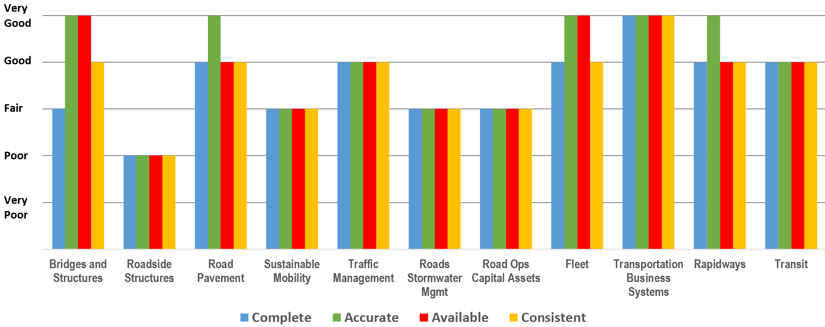
State of Asset Data
Data Condition Profile
95 – 100%
90 – 95%
80 – 90%
70 – 80%
0 – 70%
Notes:
The condition profile of transportation data assets is shown in here. Here you can see each bar graph represents the condition quality assessments for data completeness, accuracy, availability and consistency.

Slide 21
Levels of Service

Slide 22
Levels of Service
Customer & Technical LOS
Notes:
For LoS we used the Region’s corporate LOS framework with categorizes Levels of services into the service attributes for:
Capacity – which includes data completeness
Reliability – which consists of data accuracy
Condition – which covers the availability and consistency of data
Financial – which includes the affordability and sustainability of data services.

Slide 23
Levels of Service
Capacity and Reliability LOS
Service Attribute | Customer LOS |  | Technical LOS
 | Statements | Current Performance | Performance Indicators | Asset Category | Current Performance | Performance Confidence
Capacity | Data is complete | Fair | Provide data required to meet demand | Bridges and Structures | F | Medium
 |  |  |  | Roadside Structures | P | Medium
 |  |  |  | Road Pavement | G | Medium
 |  |  |  | Sustainable Mobility | F | Medium
 |  |  |  | Traffic Management | G | Medium
 |  |  |  | Roads Stormwater Mgmt | F | Medium
 |  |  |  | Road Ops Capital Assets | F | Medium
 |  |  |  | Fleet | G | Medium
 |  |  |  | Rapidways | G | Medium
 |  |  |  | Transit | G | Medium
Reliability | Data is accurate | Good | Provide data that accurately reflects reality | Bridges and Structures | VG | High
 |  |  |  | Roadside Structures | P | Medium
 |  |  |  | Road Pavement | VG | High
 |  |  |  | Sustainable Mobility | F | Medium
 |  |  |  | Traffic Management | G | Medium
 |  |  |  | Roads Stormwater Mgmt | F | Medium
 |  |  |  | Road Ops Capital Assets | F | Medium
 |  |  |  | Fleet | VG | High
 |  |  |  | Rapidways | VG | High
 |  |  |  | Transit | G | Medium
Notes:
Here is a sample of the LOS framework completed.
Here we can see the service attribute, customer LOS, current performance, Performance Indicator and asset category, current performance of each asset and performance confidence.

Slide 24
Future Demand
Demand Management Plan Summary
Demand Drivers | Impact on Data Services | Demand Management Plan
Growth | Increased demand for all data lifecycle activities (create location and description data, collect AM Planning data, analyse data, maintain data) | Non-asset solutions to reduce asset portfolio size including operational efficiencies
Service and Asset Downloads and Uploads |  | Non-asset solutions to reduce the data services including improved as built and asset handover data
Aging Infrastructure | Increased demand to collect dynamic AM planning (condition) data | Automate data collection
 | Increased demand to recreate location and description data and condition data upon rehabilitation or replacement | Non-asset solutions to reduce the data services including improved as built and asset handover data
AM Planning for O.Reg. 588/17 | Increased need to create and collect different data attributes and analyse different measures | Improve AM processes, people, systems and data including business intelligence
Technology Innovations
 | increased demand for real-time AM planning data
 | Increased need for “big data”: volume, velocity, value and variety | Increase understanding of benefits and use of business intelligence among stakeholders
Data Sharing | Increased demand to maintain data (more stakeholders to make data available to when needed and more datasets to assure consistency across) | Educate data managers, stewards and producers about the needs of all consumers
Notes:
Demand drivers that may impact future data service delivery and use of data assets are shown here. These include demand drivers related to:
Growth, Service and Asset Downloads & Uploads, Aging Infrastructure, AM Planning for O.Reg.588/17, Technology Innovations, and Date Sharing:

Slide 25
Risk Management

Slide 26
Risk Management Plan
Communication & Consultation
Establishing the context
Monitoring & Review
Risk = Likelihood x Consequence
Risk assessment
Risk identification
Risk analysis
Risk evaluation
Identify critical data assets
Quantify Risks
Inform Lifecycle Activities
Risk treatment
ISO 31000 Risk Management Standard
Notes:
The risks for data assets can be assessed like how you would assess the risk for any asset.
We leveraged the ISO 31000 Standard for Risk Management Risk to identify critical data assets and to quantify risk (low, medium, high) to inform and prioritize of lifecycle activities.

Slide 27
Risk Management Plan
Notes:
For the AMP, the risks were defined as adverse impacts on the Region’s ability to meet current and proposed customer LOS statements as measured by the technical LOS performance indicators, as summarized here.

Slide 28
Risk Management Plan
Likelihood Evaluation Table
Likelihood Grade | Description | Probability of event occurring in a year | Data Quality
1 | Rare | < 10% | Very Good
2 | Unlikely | 10% to < 35% | Good
3 | Possible | 35% to < 65% | Fair
4 | Likely | 65% to < 90% | Poor
5 | Almost certain | >= 90% | Very Poor
Consequence Evaluation Table
Grade | Description | Criticality of Data | Service Delivery | Financial
1 | Very Low | Data provides aspirational information on assets or is considered optional | Small number of customers experiencing impact (less than 1% or up to a few hours) | Damages, losses (including 3rd party) or fines from $1k to $10k
2 | Low | Not used | Localized service impact (1% to 2.5% or up to 1 day) | Damages, losses (including 3rd party) or fines $10k to $100k
3 | Moderate | Data provides an enhanced view and supports greater details in analysis, visualisation and understanding of the current and predicted state of assets | Significant localized impact (2.5% to 10% or less than 1 week) | Damages, losses (including 3rd party) or fines $100k to $1M
4 | High | Not used | Major service impact (10% to 50% or for more than a week) | Damages, losses (including 3rd party) or fines $1M to $10M
5 | Very High | Data required to meet regulations, develop AM plans, report on asset performance, program proactive AM and maintenance, or share with stakeholders | Wide service impact (50% to 100% or permanent loss of services) | Damages, losses (including 3rd party) or fines > $10M
Notes:
To assess and quantify the risks we used LoF and CoF tables adopted by the Region.

Slide 29
Risk Management Plan
Shortlist of Very High and High Risks
Identify Risks |  | Analyze Risks |  | Evaluate Risks | Treat Risks
Risk Trigger Category | Possible Event | Likelihood | Consequence | Current Risk Score | Proposed Risk Control
Poor Quality Data | causes poor quality location and description data | 4 (Likely) | 5 (Very High) | 20 (Very High) | Add rigour to the QA/QC process for as-constructed drawings and handover documents for new assets and downloads / uploads
 |  |  |  |  | Improve the data quality for existing assets by creating location and description data and collecting AM planning data where incomplete or inaccurate
Growth | causes expansion of regional transportation services and assets | 5 (Almost Certain) | 5 (Very High) | 25 (Very High) | Decrease service and infrastructure demand through non-asset solutions
Service and Asset Downloads and Uploads |  |  |  |  | Increase service and infrastructure capacity by maximizing effectiveness of existing road network
 |  |  |  |  | Increase data service capacity by adding staff and expanding existing datasets
Aging Infrastructure | causes increased frequency to collect AM Planning data | 4 (Likely) | 5 (Very High) | 20 (Very High) | Automate data collection where possible
 |  |  |  |  | Increase AM planning data capacity by adding staff and expanding existing datasets
Funding Gaps | causes underfunded data practice | 4 (Likely) | 3 (Moderate) | 12 (High) | Add much more detail to the budgets and link budget accounts to data management activities and associated resource requirements, by program and asset type

Slide 30
Lifecycle & Financial Strategy
Notes:
Now let’s look at the lifecycle strategy

Slide 31
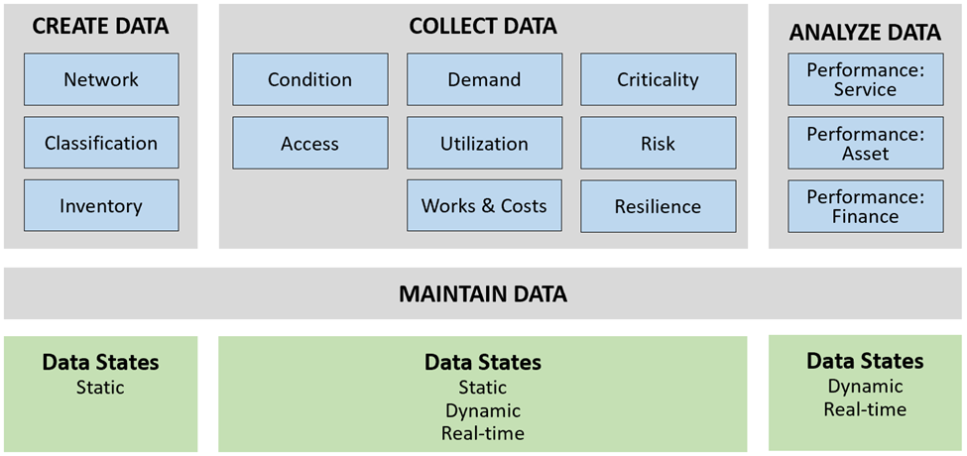
Lifecycle Strategy
Asset Data Phases, Function Groups and Data States
Lifecycle Phase
Function Group
Data state
Notes:
As mentioned earlier, the lifecycle management of data includes the phases of data creation, collection, analysis and maintenance.
Data creation: Activities to provide location and description data
Data collection: Activities to provide AM planning data
Data analysis: Activities to examine raw data to make AM performance decisions
Data maintenance: Activities to retain data assets in an appropriate service condition – available when needed and consistent over time (cleaning, storage, disposition)
This figure shows the key data lifecycle phases (grey), the relevant function groups (blue), and the data states (green).

Slide 32
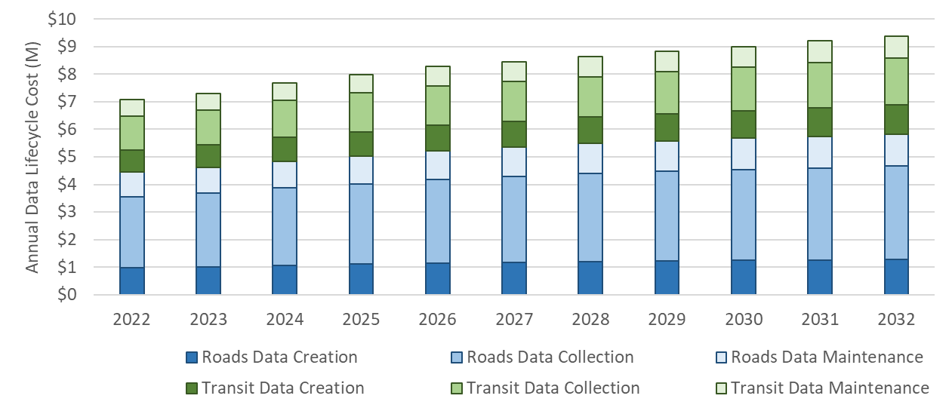
Lifecycle Strategy
Asset 10-Year Data Lifecycle Needs
2023 Budget
allocation for data:
- Capital: $1.2 M
- Operating: $5.1 M
- Total: $6.3 M
Gap for 2023 ~$0.8 M,
and increasing as
asset data needs grow
Notes:
This figure shows the 10 year data lifecycle needs for roads and transit AM data.
Through analysis, it was found that there was a $800K gap for 2023. Total gap over the 10 year period could not be determined because the amount of operating funding available for data activities is unknown.

Slide 33
Financial Strategy
Funding gaps over the next 10 years based on available information:
$5 million to improve the data quality for existing assets
$2.32 million to expand data services for creation, collection and maintenance required to meet the needs of the growth of the roads and transit asset portfolios
$0.5 million to modify collection of AM planning data including processes, people, systems, and data
$250,000 to modify data maintenance processes, people, systems, and data to accommodate greater sharing of data among stakeholders.

Slide 34
Plan Improvement
Notes:
Now let’s look at the lifecycle strategy

Slide 35
Improvement Plan
No | Task | Description | Responsibility | Resources Required | Timeline
1 | Expand Data Services | Plan for ~ 30% increase in demand for data creation, collection, maintenance and analysis over the next 10 years due to growth of the asset portfolio. | Data Managers | 5.0 FTE | Over next 10 years
2 | Improve Budgeting for Data | Add much more detail to the budgets (particularly operating) and link budget accounts to data management activities (i.e., data creation, collection, maintenance and analysis) and associated resource requirements, by program and asset type. | Data Stewards | 0.5 FTE | Next budget cycle
3 | Share Data | Map the use of data across the Region and by external stakeholders to fully understand the benefit derived from the data, the associated risks of poor data management practices, and appropriate costs for data management. | Data Stewards | 1.0 FTE | Over next 2 years
4 | Plan to Improve Data Quality and Availability | Add more rigour to: a) QA/QC processes for as-constructed drawings and handover documents and data b) data creation and collection processes for assets uploaded from or downloaded by others and following changes to assets in the field, including developing condition assessment protocols c) managing metadata for easy data retrieval. | Data Stewards | 0.5 FTE | Over next year (before ~ 30% expansion in asset portfolio)
5 | Improve Data Quality | Improve the data quality for existing assets by creating location and description data and collecting AM planning data where incomplete or inaccurate. | Data Stewards | 5.0 FTE | Over next 10 years
6 | Modify Practices for More Complex Data | Modify collection of AM planning data including processes, people, systems and data to accommodate O.Reg. 588/17 requirements, more complex assets, new real-time data collection technologies and use of business intelligence tools, and communicate changes to all stakeholders. | Data Custodians | 1.0 FTE | Opportunistically over time

Slide 36


Thomas MacPherson
Thomas.MacPherson@york.ca
Aman Singh
Aman.Singh@slbc-inc.com

